Slide 1
Social Inclusion: Everyone is welcome and can belong
Creating a social inclusion movement in Waterloo Region!
May 30, 2018

Slide 3
Goals for today
To engage the community in conversations about:
What gets in the way of wellbeing.
Obtain insights on the actions to create a social inclusion movement.
Invite participation in Wellbeing Waterloo Region to support future actions.
Notes:
(Why do we take the time to do a land acknowledgement?)
To recognize the land is an expression of gratitude for the earth and all life within it, and it is also a way of honouring the Indigenous people who have been living on and caring for this land for thousands of years---the land on which our successes have been built. A land acknowledgement is a longstanding protocol among Indigenous peoples and today we offer it as an act towards reconciliation.

Slide 4
Land Acknowledgment
We are grateful and honoured to have the opportunity to open this workshop today with a land acknowledgment as we take some steps in our own social inclusion process.
The land acknowledgement is a way of honouring the Indigenous people who have been living on and caring for this land for thousands of years---the land on which our successes have been built.
Notes:
So, we are grateful and honoured to have the opportunity to give the land acknowledgement to open this workshop today as we take the first few steps in our own process to create a movement that acknowledges bias, seeks equity, prevents isolation and strengthens belonging for everyone.
This land acknowledgement is a way of honouring the Indigenous people who have been living on and caring for this land for thousands of years---the land on which our successes have been built. Today we offer it as an act towards reconciliation.
In that spirit we invite you to join us by standing or you can stay seated and joining us in this land acknowledgement as an act toward reconciliation ….

Slide 5
We invite you to join us
I invite the planning group to come up and join me as hosts of the workshop today.
And in that spirit we invite you to stand (or stay seated) and read together aloud the land acknowledgment as an act toward reconciliation ….
On your program and on next slide.

Slide 6
Land acknowledgement
We would like to begin by acknowledging that the land on which we gather today is the land traditionally used by the Haudenosaunee, Anishinaabe and Neutral People. We also acknowledge the enduring presence and deep traditional knowledge and philosophies of the Indigenous People with whom we share this land today.

Slide 7
Is a community lead initiative made up of citizens, service providers, community organizations, government, business etc.
We are working together to identify priorities.
To create significant and impactful actions to improve wellbeing in our community.

Slide 8
Where do we start?
But where do we focus to really make a difference on wellbeing?
Priorities and solutions need to be informed by public input and evidence.
We gathered data and have developed a profile of wellbeing for Waterloo Region.
We have been engaging the community in conversations to identify priorities.
Using multiple methods to invite and engage participation.
Trying to include all voices in the process.

Slide 9
Narrow our focus
Public input
Statistics and trends
3 big areas
Notes:
So we collectively made sense of the data both public input and the statistics and trends and there were many priorities identified.
Basically everything is a priority to someone.
We developed criteria and applied this criteria to identify four big ideas to place initial focus on.
Some examples of criteria were
Evidence based and is supported by data and community input.
Greatest potential for meaningful change.
Will have multiple impacts on many aspects of wellbeing.
Is measureable and we will know if we are making a difference.
Everyone can play a role in creating actions.
Is a rallying call that inspires the community to make change.

Slide 10
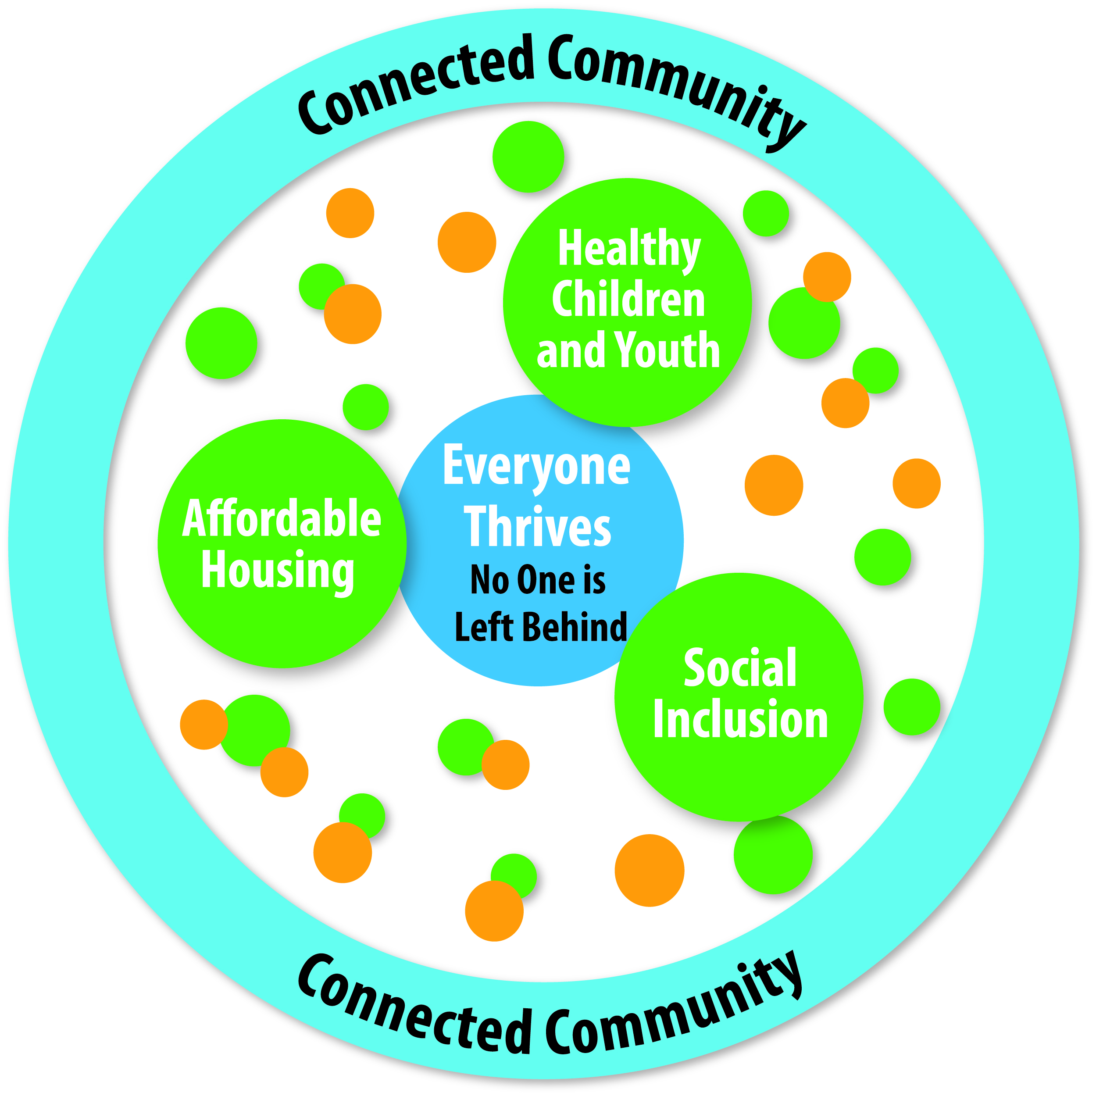
Notes:
The four big ideas are:
Affordable Housing:
Everyone has a place to call home.
Healthy Children and Youth:
All children and youth have the foundation they need to thrive and reach their potential.
Social Inclusion: Welcoming communities embrace diversity, reduce social isolation, enhance relationships and enable everyone to belong.
Connected community:
And circling around these three big ideas is our connected community.

Slide 11
Big idea
Social Inclusion: Everyone is welcome and can belong.
Challenge
Create in Waterloo Region a social inclusion movement that seeks equity, prevents isolation and strengthens belonging.

Slide 12
What did we hear regarding social inclusion?
In order to have wellbeing for everyone we need to:
Foster respectful and meaningful relationships with each other.
Create intercultural understanding and connection.
Prevent isolation and deepen connection.
Strengthen belonging for everyone.
Acknowledge our unconscious biases so we can be a catalyst for reconciliation.

Slide 13
Today
Today we are here to identify actions to address social inclusion.
Started to gather ideas on actions.
Conducting a scan of existing work.
Handout summarizing this when you came in.
If you are interested in the other big idea areas we can get you involved --- just not today.

Slide 14
Any questions?

Slide 15
Social Inclusion Movements
John Lord
Researcher, author, and facilitator.
Founder and first director of the Centre for Community Based Research in Kitchener,
Author of seven books, including Pathways to Inclusion and Facilitating an Everyday Life.
Member of the New Story Group of Waterloo Region and serves on the Reference Group for Wellbeing Waterloo.
He recently was awarded the Order of Canada for his contributions to Canada.

Slide 16
Social Movements: Insights for Inclusion
Presentation to
Insights into Inclusion
Wellbeing Waterloo
John Lord
May 30, 2018
www.facilitationleadership.com

Slide 17
When you think of Social Movements,
what comes to mind?
Civil rights movement
The women’s movement
The environmental movement
MeToo movement
Social movements impact
attitudes and practices
www.facilitationleadership.com

Slide 18
The Inclusion Movement
Roots of the Inclusion Movement…
Independent living movement
Community living movement
Mental health movement

Slide 19
How Inclusion Movement Grew
By early 2000’s, social inclusion was identified as a social determinate of health
“Inclusion is good for you, it expands your relationships, and can enhance your health and well-being.”
More groups began to embrace inclusion – public health, crime prevention, urban planning…

Slide 20
Attributes of Social Movements
What we can learn from inclusion movement research:
Human rights based and grievance oriented
Strong leadership
Mobilized members/ citizens
Focus on community and people’s gifts
Strategic and relationship focused

Slide 21
Most of all, movements prepare the ground for new ways of thinking and acting
INCLUSION shifts our thinking to community and to belief in the capacities of everyone

Slide 22
What Actions do Social Movements Take?
They sponsor campaigns (Breadth)
They take actions that demonstrate the campaign’s vision (Depth)
We need campaigns AND local actions (Breadth and depth)

Slide 23
How Can we Build on What we Know About Social Movements?
From personal experience and research:
Make it personal
Build on existing good works
Move beyond silos – collaborate across sectors and areas

Slide 24
“There is nothing more powerful than an idea whose time has come.”
Victor Hugo

Slide 25
Circle panel discussion
Ruth Cameron
Jessica Duke
Sharon Livingstone
Pari Karem
Fauzia Mazhar
Dianne Roedding
Timothy Ninomiya
Empty Seat

Slide 26
Mindfulness Meditation
Helps you to open your mind and hear what is being said – beginners mind.
Provides the space to get you to pause, reflect and respond with purpose.
Helps to open your heart to the conversation and not react or be defensive about what is being said.
Sets the intention for conversation.
Breath – with JusTme

Slide 27
Table discussions
What are the barriers or things that get in the way of inclusion that you want to add from the panel conversation?
From your experience and from what you heard today how can we work to enhance inclusion and create a social inclusion movement?
Quick and easy ideas
Practical and powerful
Off the wall ideas
How do we support and encourage inclusive participation in Wellbeing Waterloo Region?

Slide 29
Next steps
Form the structure with working groups and tools to connect people and groups.
Identifying funding and resources to support the work going forward.
Engage with the community to create actions that will have the most impact in the 3 big idea areas.
Continue to gather research and promising practices – send any research or initiatives on social inclusion.
Develop indicators to measure progress on our actions.
Next Wellbeing Waterloo Region Forum on June 20, 2018 in Cambridge.
Conducting a community wide survey with residents of Waterloo Region to set the benchmark.

Slide 30
Wellbeing Waterloo Region Survey
Help shape happy and healthy communities in Waterloo Region!

Slide 31
Take the Survey and have your say!
Help us shape the future of wellbeing in Waterloo Region.
In only 30 minutes you can help shape future priorities and identify where change is needed most in our communities.
The survey can be found at www.CIW.ca/WaterlooRegionSurvey
Notes:
We have tested the survey and found it takes about 30 minutes to complete. You can exit the survey at any time before completing it, and then go back later to finish it. The survey will return you to the point in the survey where you left so you do not have to go through it all again.

Slide 32
We need your help to promote the survey
Share the postcards / posters and encourage your co-workers, clients you work with, neighbours, friends, and family to complete the survey.
Help people conduct the survey if they have barriers to complete it
See the website for ways you can help promote the survey at:
http://www.wellbeingwaterloo.ca/blog/help-promote-the-survey/
Notes:
We need your help to promote the survey to ensure we hear from a diverse range of people. The more people that complete the survey the more we can understand about wellbeing in our community.
You can help us by sharing the postcards and encouraging your co-workers, clients you work with neighbours, friends and family to complete the survey.
Some examples of opportunities to promote the survey and encourage people to complete the survey:
If you are a manger, set aside time for your employees to complete the survey
If you live in an apartment building, put up posters or share the postcards with others and encourage people to complete the survey
If you are part of a team, or a group, encourage everyone in the group to take the survey
If you are attending an event bring postcards to share at the event.
For ideas about how to promote the survey and for sample communications (e.g. emails, tweets, etc.) that you can use to promote the survey please see the website at XXXXXX
If you need posters or postcards, Lorie Fioze, Manager of Strategic Planning and Strategic Initiatives, Region of Waterloo at 519-575-4758 or lfioze@regionofwaterloo.ca
The Community Wide Survey will be launched late April with the first promotion coming out in Region news on April 16th. There will be other ways we will be promoting the survey and they include:
Social media
Twitter
Facebook
Website banners and content
Promotional paper post cards and posters
Emails and newsletter articles to networks
Digital signs
In order to reach as many people as possible, we need your help to promote the survey! We have crated a website with ways that you can help promote the survey. Please help to encourage your friends, neighbors, colleagues, people you work with, etc. to take this survey.
Also if you have any events that we can advertise or promote the survey at please let Lorie Fioze know.

Slide 33
Next steps & wrap up
Invite you to participate in working groups.
Yellow involvement card.
Subscribe on the Wellbeing website for updates.
Complete the wellbeing survey.

Slide 34
Thank you!
Workshop planning group
Presenters
Table facilitators
Set up crew
Glenn Pothier
And to all of you for participating
Complete blue feedback forms.

